Slide 1
Feb 16

Slide 2

Transformer

Slide 3

GNN

Slide 4
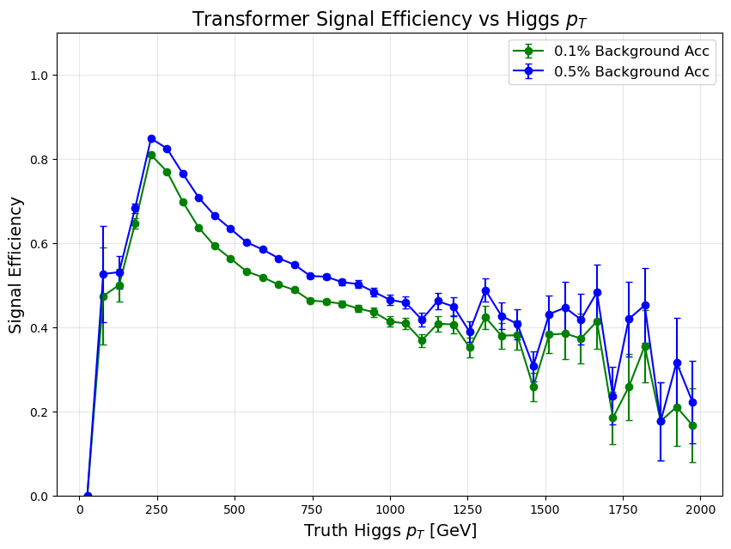

Slide 5
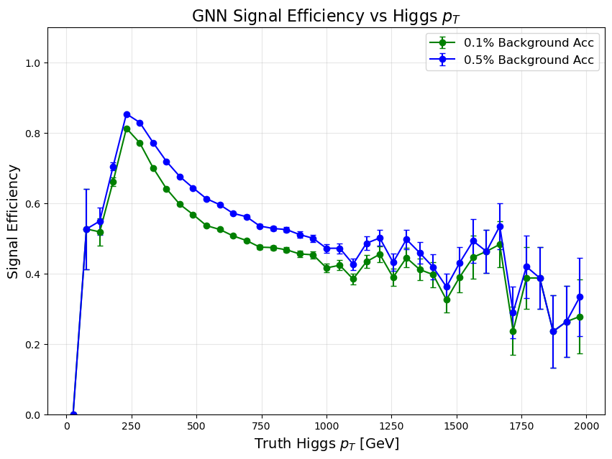

Slide 6
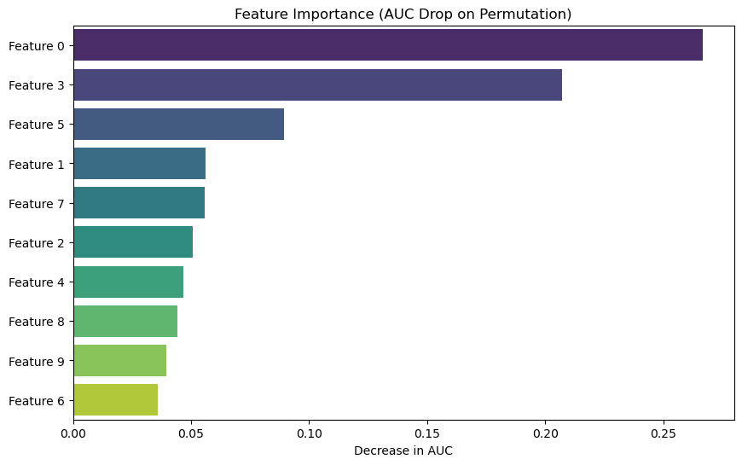

Slide 7
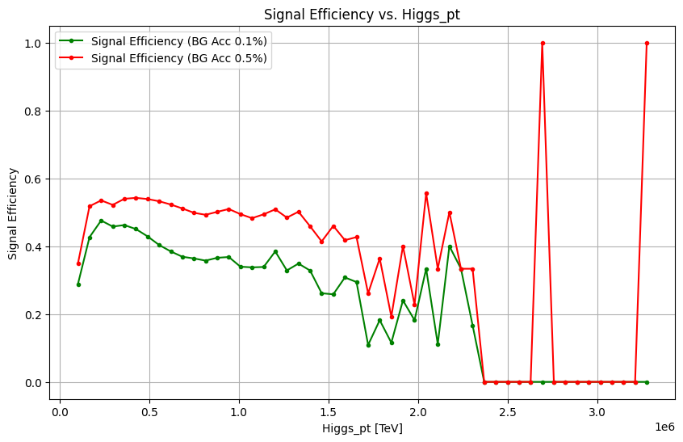

DNN baseline results from before:

Slide 8
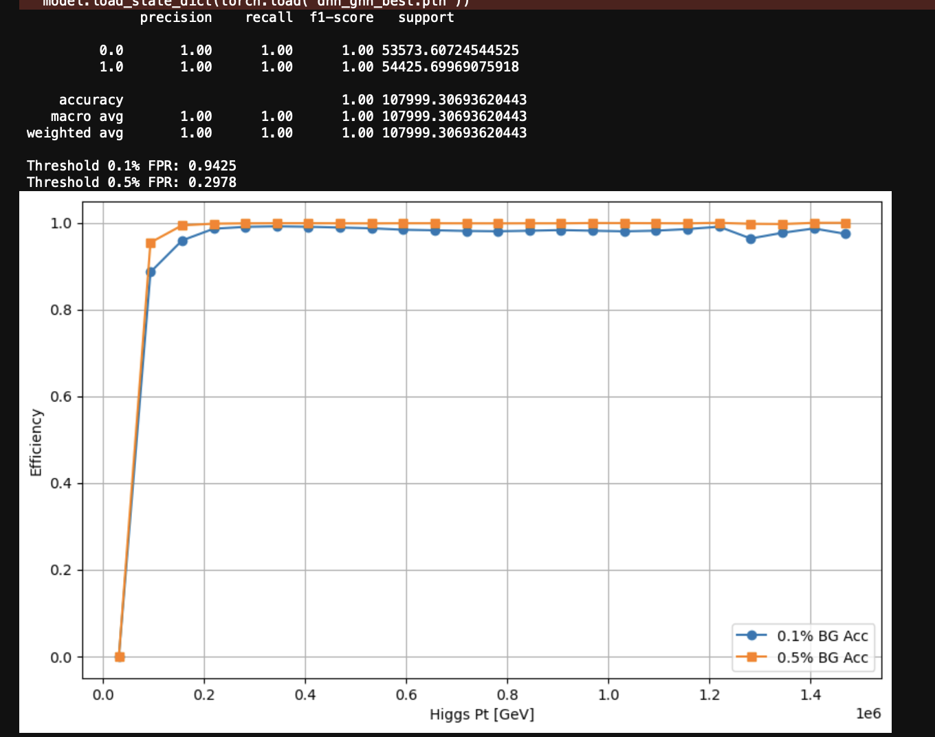
Combined:

Slide 9


